Slide 1
Mathematical Model Details

Slide 2
Overview
Motor PWM Values
Conversions (If Necessary)
+
PID
Desired Pitch
PID
Appropriate Summations
Duty Cycle to PWM
Drone
-
+
Desired XY Position
-
Desired Roll
+
PID
+
PID
Duty Cycle to PWM
-
-
Desired Yaw
+
PID
Duty Cycle to PWM
-
Estimated XY Position
Desired Elevation
+
PID
Duty Cycle to PWM
-
Sensor Feedback (May need to operations with these when feeding back)

Slide 3
PID Variables
PID
e[]
Array of size ??? holding error values from sampled sensor values.
Most recent value is held at the end(?)
P, I, and D
Gain values for each part of the PID controller.
sum
“Integration” of e[] (see “Integral Details” slide)
slope
“Derivative” of e[] (see “Derivative Details” slide)
dutyCycle
Final output: gives the Duty Cycle of the PWM signal that needs to be generated (valued from 0 to 255, NOT 100. Because that’s the way the 8-bit-resolution-pwm-cookie crème brûlées)

Slide 4
Duty Cycle Calculation
PID
dutyCycle = P*e[last] + I*sum – D*slope
if(dutyCycle > 255) {
dutyCycle = 255;
}

Slide 5
Integral Details
PID
sum will keep track of the integration so far.
for each new sample:
sum += e[last] //assuming the most recent element is in the last position
Additional operations needed to correct overshoot (see “Overshoot Correction”)

Slide 6
Derivative Details
PID
2 Options to solve for slope (2 is probably best)
ACTUALLY, 1 might be best if we downsample before getting error values.
(most recent e) – (2nd most recent e)
Pros:
More responsive
Cons:
Noise can really mess stuff up, and can also be twitchy
(average of N most recent or e[]) – (average of the next N of e[])
Pros:
Resists noise effects
Cons:
Slower response

Slide 7
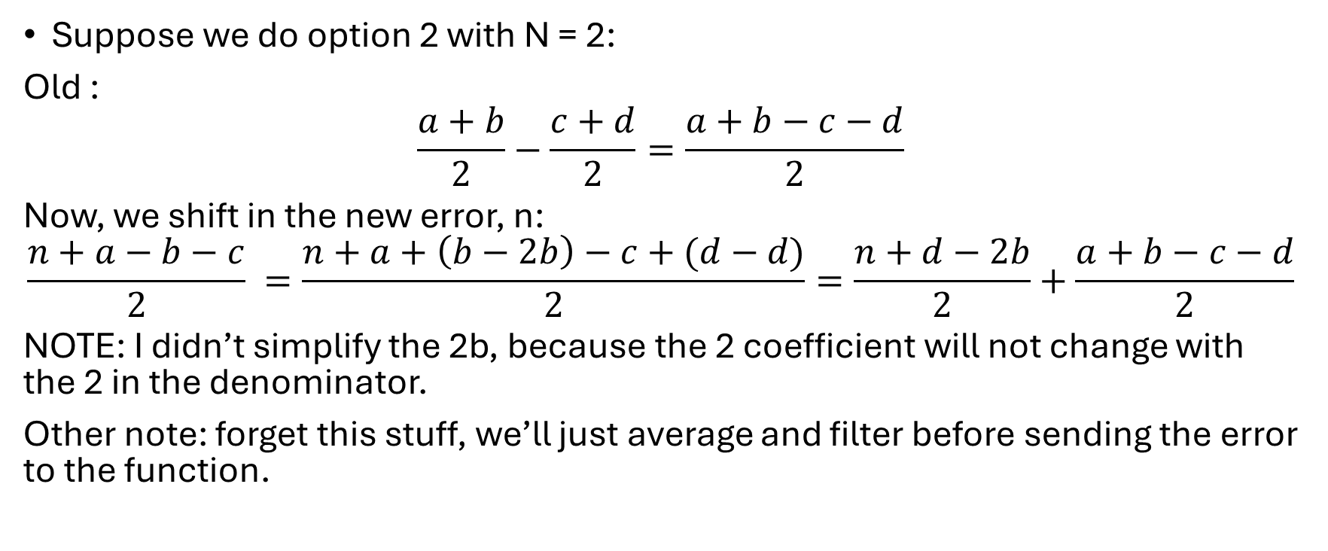
MORE Derivative Details
PID
Suppose we do option 2 with N = 2:
Old :
$$\frac{a+b}{2}−\frac{c+d}{2}=\frac{a+b−c−d}{2}$$
Now, we shift in the new error, n:
$$\frac{n+a−b−c}{2} =\frac{n+a+\left(b−2b\right)−c+(d−d)}{2}=\frac{n+d−2b}{2}+\frac{a+b−c−d}{2}$$
NOTE: I didn’t simplify the 2b, because the 2 coefficient will not change with the 2 in the denominator.
Other note: forget this stuff, we’ll just average and filter before sending the error to the function.

Slide 8
Overshoot Correction
PID
Need to cap sum to some value.
255 would work but we could probably cap it at a smaller value.

Slide 9
Appropriate Summations
Appropriate Summations
M_{fl} = Thrust + Yaw - Pitch + Roll
M_{fr} = Thrust - Yaw - Pitch - Roll
M_{br} = Thrust - Yaw + Pitch + Roll
M_{bl} = Thrust + Yaw + Pitch - Roll

Slide 10
Duty Cycle to PWM Block
Duty Cycle to PWM
Things to keep in mind:
T_{DutyCycle} <= T_{sample}
T_{DutyCycle} should be some multiple of T_{sample}

